Slide 1
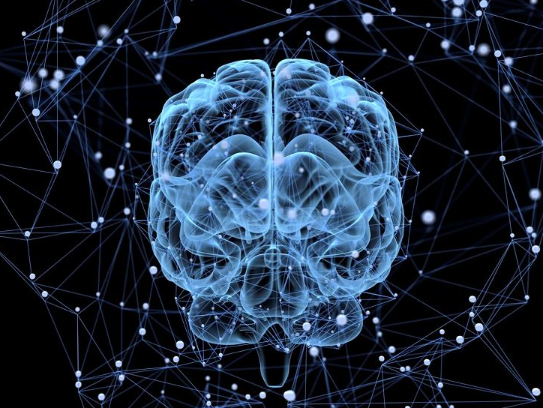
Understanding Human Intelligence: The Neocortex and Memory
(On Intelligence by Jeff Hawkins Chapter 3 & 4)
Meta Kiat-arpadej 2022326660020

Slide 2
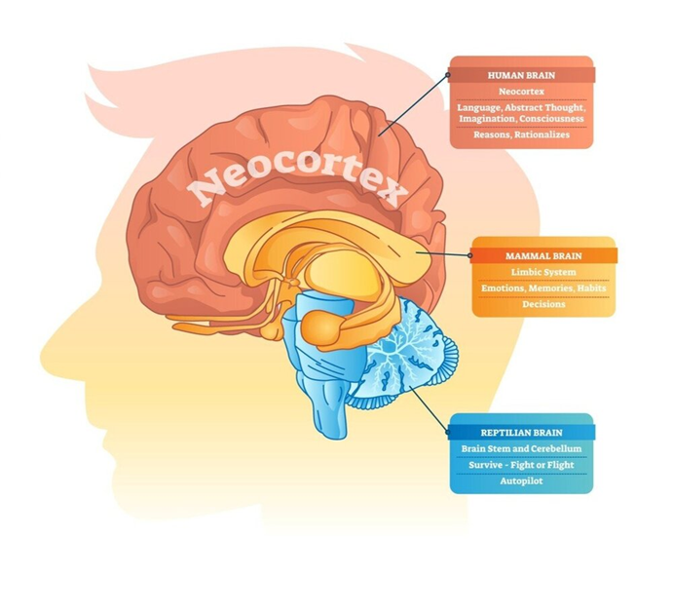

Chapter 3 human Brain
Neural networks still wouldn’t allow computers to perceive the world in the way humans do. That’s because the human brain consists of one key element in intelligence: the neocortex. The neocortex is the part of the brain responsible for sensory perception and conscious thought. Almost everything we think of as intelligence - perception, language, imagination, mathematics, art, music, and planning - occurs here. The neocortex is about 2 millimeters thick and has six layers, imagine six playing cards stacked upon one another. As information from the senses travels through each layer, each one adds detailed prior knowledge to the raw sensory information.
Notes:
Many people thought that neural network is the exact copy of our brain functionality. However, Jeff Hawkins didn’t believe so.

Slide 3
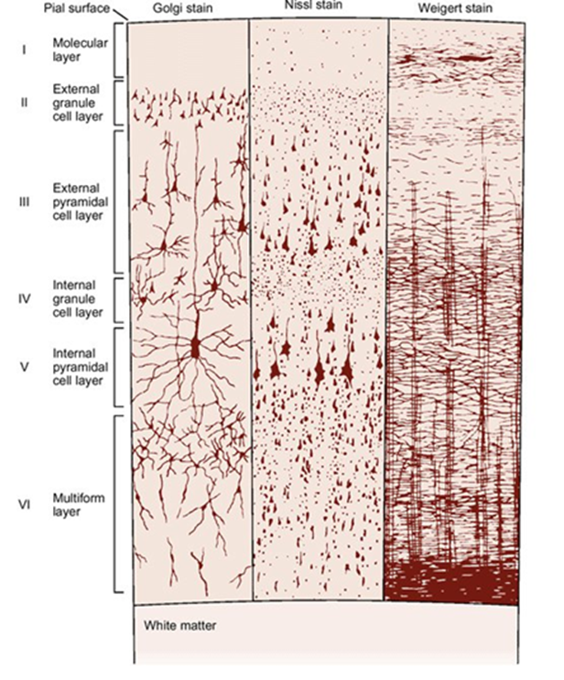

Neocortex
Additionally, your neocortex is filled with nerve cells or neurons. But they are so tightly packed that no one quite knows precisely how many cells they contain. Some anatomists have estimated that a typical human neocortex contains around 30 billion neurons, but that figure could be significantly higher or lower. Those thirty billion cells, however, are you. They contain all your memories, knowledge, skills, and accumulated life experience. That thin sheet of cells sees, feels, and creates our worldview. For example, when you look at a familiar face, your brain begins to receive this information.
Notes:
Estimated number of neurons 30 billions and their significance
Emphasize that these neurons contain memories, knowledge, skills, and life experiences.

Slide 4
Neocortex Processing Recognition
The lower layers of the neocortex process this visual information and focus on things like basic color and contrast information. This area then feeds the information up to other areas until it reaches the higher echelons of the visual cortex that then recognizes the face you see as that of your spouse, child, or boss.
Notes:
As information from the senses travels through each layer, each one adds detailed prior knowledge to the raw sensory information.

Slide 5
Patterns in the neocortex
The neocortex is full of patterns. Brains are pattern machines. No matter if you see, hear, or touch something familiar, your brain goes through the same algorithm. This means that you don’t need any one of your senses or a particular combination of senses to be intelligent.
The neocortex is incredibly fast and efficient and can connect prior knowledge that you aren’t even consciously aware of. The brain knows the world through a set of senses, these senses create patterns that are sent to the neocortex and processed by the same algorithm to create a model of the world. This is what allows humans to experience the world in such a fluid and seamless way. Even more remarkably, the brain then holds those patterns in memory to access for future reference. In other words, our brains are just a growing database of memories and knowledge that we continuously build upon. Something computers simply cannot do yet.

Slide 6
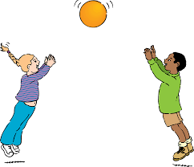
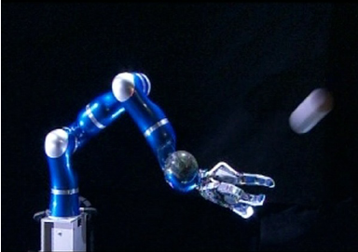
Chapter 4 memory
memory

Slide 7
memory
memory
When you catch a ball using memory, three things happen. First, the brain automatically recalls a memory by the sight of the ball. Second, the memory recalls a temporal sequence of muscle commands. And third, the retrieved memory is adjusted as it is recalled to accommodate the details of the moment, such as the ball’s path and position of your body. The memory of how to catch a ball was not programmed into your brain; it was learned over years of repetitive practice. The memory is stored, not calculated, in your neurons. The neocortex, unlike a computer, uses stored memories to solve problems and produce behavior. In other words, it uses a sequence of patterns in the memory to react or predict the current event or future behavior.
The neocortex stores sequences of patterns.
The neocortex recalls patterns auto-associatively.
The neocortex stores patterns in an invariant form.
The neocortex stores patterns in a hierarchy.

Slide 8
Predicting future events
These patterns allow us to predict future events. Whenever we experience something, our brain automatically begins to search for a similar prior experience. Nerve cells that became activated by a previous experience suddenly trigger again, allowing the brain to determine the appropriate reaction this time around. For example, when we put our key into the ignition, we predict the engine will begin roaring as it starts up. We can’t ever be 100 percent sure the same will happen each time, but based on experience, our brain can predict that it will. While humans can’t necessarily see into the future, our brains can make accurate predictions. This process is ongoing as the brain continues to encounter new experiences.

Slide 9
conclusion
An reoccurrence of an event receiving through the senses is stored in the brain by neocortex layers, where each layer adds detailed prior knowledge to the raw sensory information. The brain then recalls memory stored in neocortex to response or predict to the current or future events.
Jeff Hawkins believes that by understanding how brains work, we can build machines similar capabilities to our brain, unraveling the enigma of human intelligence.
Notes:
Understand and predict make us intelligence

